Slide 1
Ra
Android version of the boardgame
By Benjamin Sklar

Slide 2
Ra
3-5 player boardgame
Auction based
Players accumulate tiles via auctions and score their tiles at end of each of 3 epochs. Tiles are grouped into various categories.
Game description: http://boardgamegeek.com/boardgame/12/ra
iOS version description: https://videogamegeek.com/videogame/86774/reiner-knizias-ra
Source: https://github.com/brskl/Ra
Video presentation: https://youtu.be/n_CXcqok1U0

Slide 3
Computer versions
iOS version
Desktop version
My Android version
v0.1 – based on class material from Fall Quarter 2016 text based with primary goal to implement game functionality
v0.2 – based on class material from Winter Quarter 2016 primary change is use of graphical elements, other changes include: multiple languages, multiple layouts, etc.
v0.3 – based on class material from Spring Quarter 2017
v1.0 – commercial version to be released to Google Play Store

Slide 4
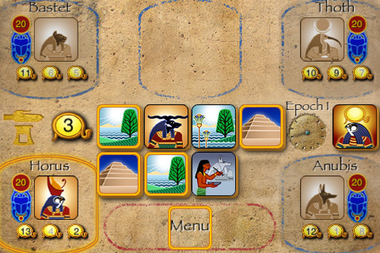
iOS version

Slide 5
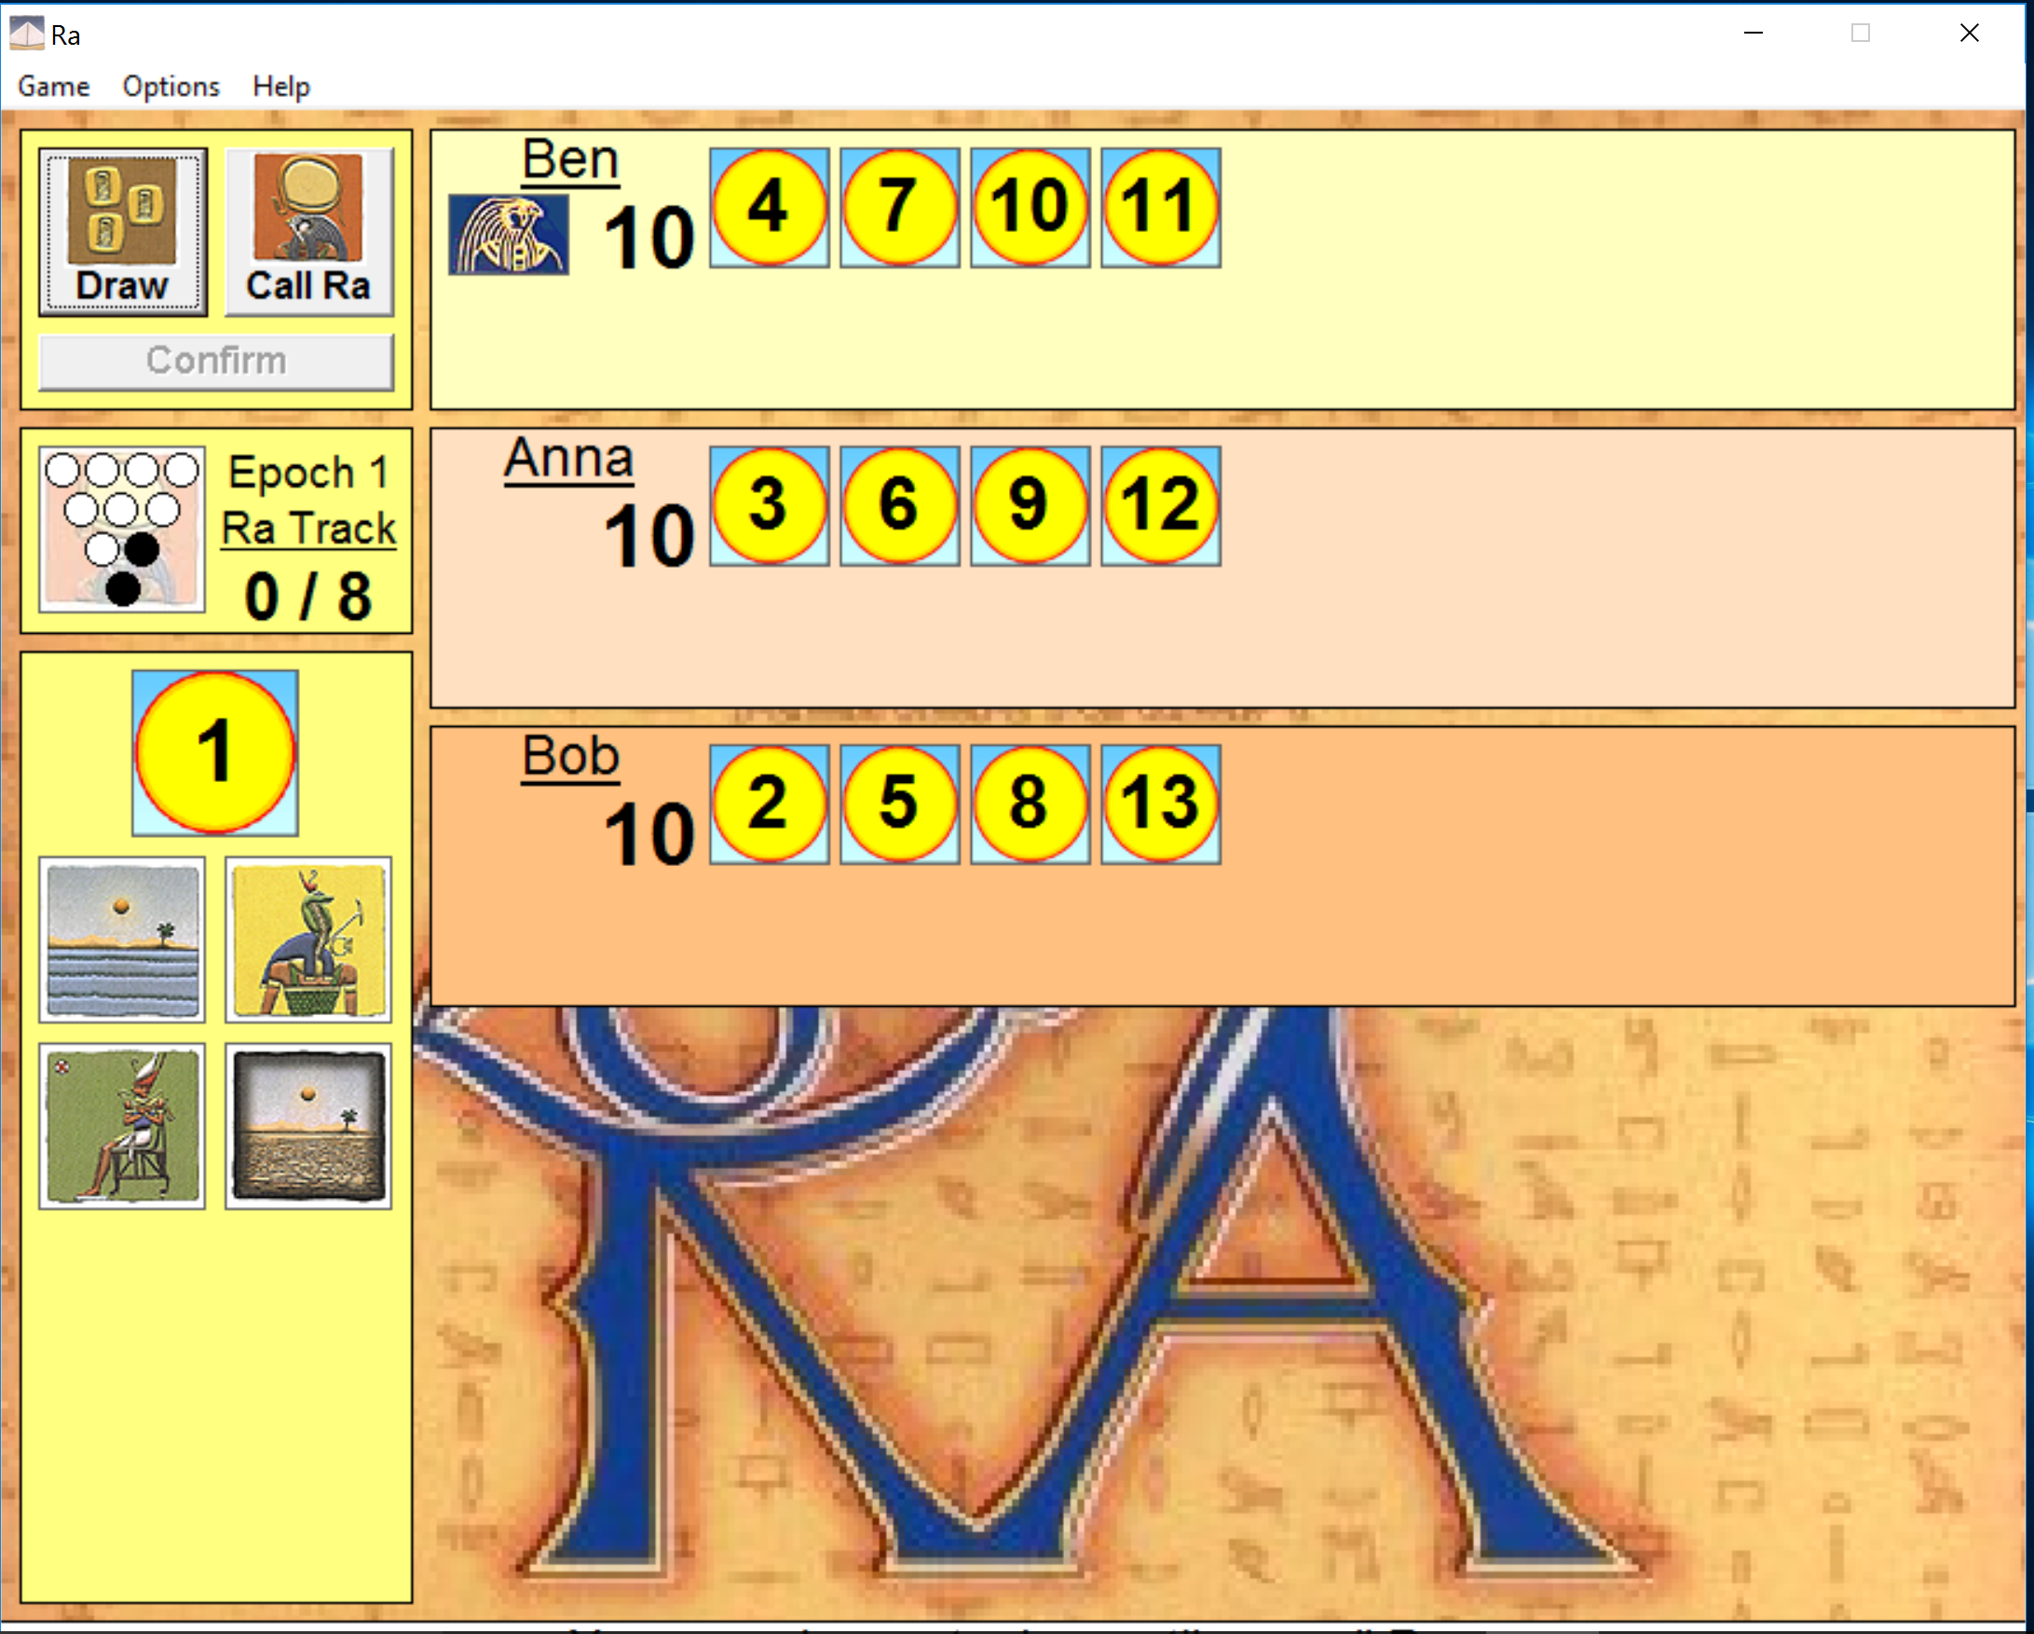
Desktop version
Notes:
Show Ra.exe and do a few moves. Author did it to implement neural network game AI Available at: http://snapper.rooms.cwal.net/games.html

Slide 6
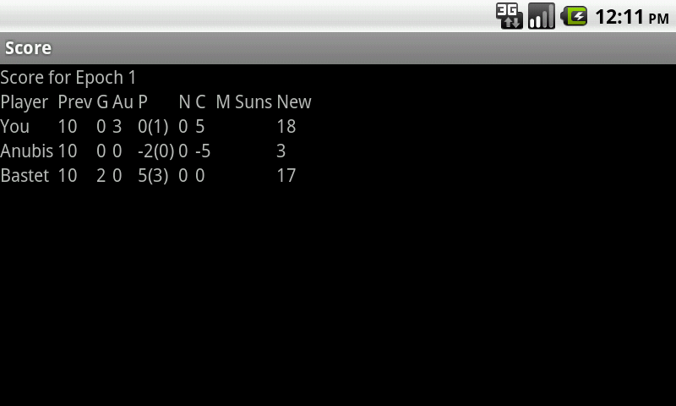
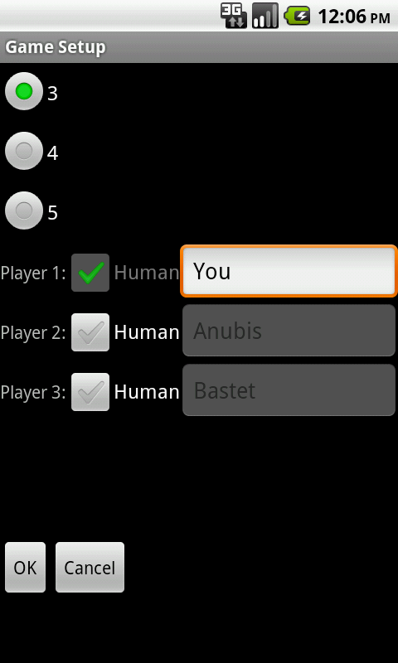
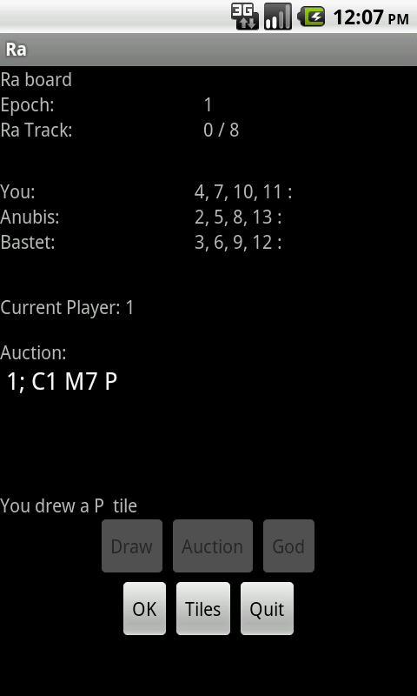
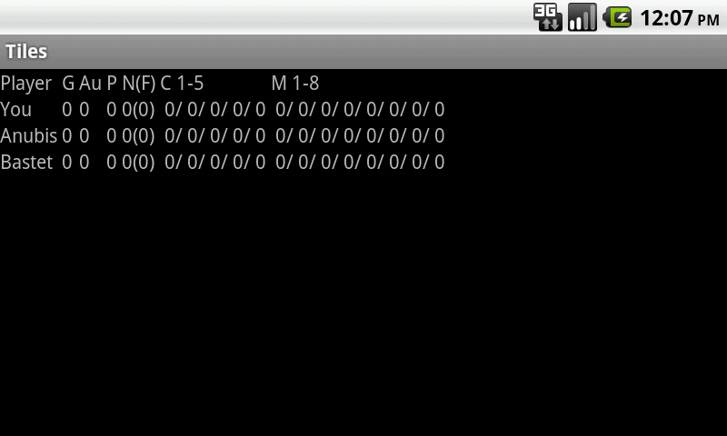
V0.1
Notes:
Textual UI. Primary goal to implement game functionality in working Android app.

Slide 7
V0.2

Slide 8
features used
String resources: Plural, multiple languages
New launcher icon w/ multiple resolutions
Animation class used on start-up activity
Multiple Layouts: portrait vs. landscape
‘Up’ navigation
Graphical images in GameActivity, ScoreActivity, TilesActivity
Saving of game state in internal file
SunImageView subclass of ImageView w/ onDraw to do text numbers over sun-tile graphic

Slide 9
Issues

Slide 10
ToDo

